Slide 1
Chicago Crime Alert
Jack Broncato
& Vismark Juarez

Slide 2
Project Overview
Product description: The Chicago Crime Application is exactly what it sounds like, it supplies a user with crime statistics and info through a user friendly interface.
Product functional capabilities: The application can: give up to date crime statistics, alert a users mobile phone of important update on either local or relevant crimes, and be used as a browser of curated news articles.
User characteristics: Users would be anyone in the Chicago area who are concerned about crime and how it may affect their daily lives, or anyone who is curious about the subject.
User operations and practices: Users can set up alerts to their mobile phone for relevant news, and query an API for crime info, having it returned in a user readable graph.

Slide 3
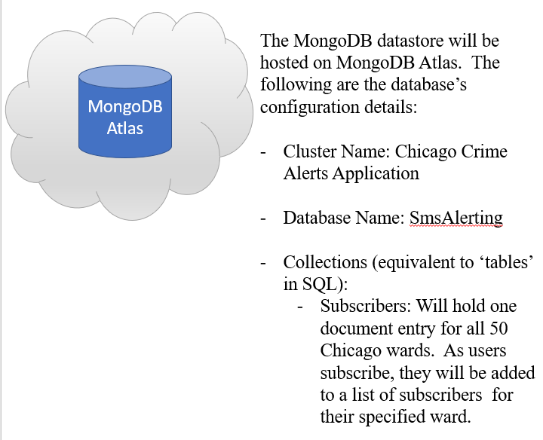
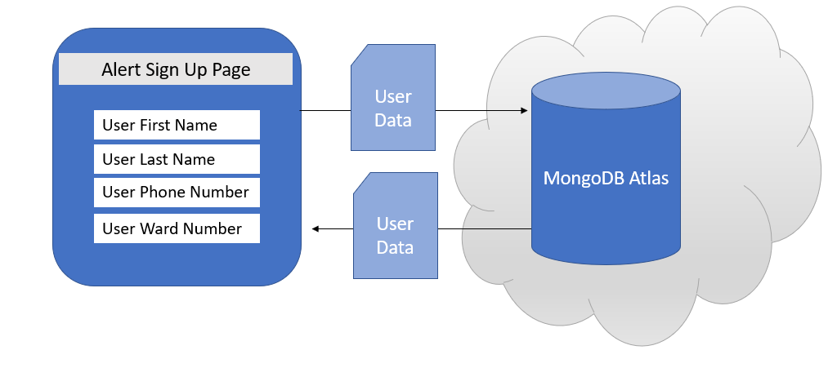
System Architecture

Slide 4
Logical View
Web Layer/Presentation: Winforms application to allow users to easily navigate/utilize the application
Business Logic Layer (BLL): Twilio/Chicago Crime API, handle processing of user data and fetching of relevant crime data for display on the presentation layer.
Data Access Layer: MongoDB database for holding user info safely and in mass

Slide 5
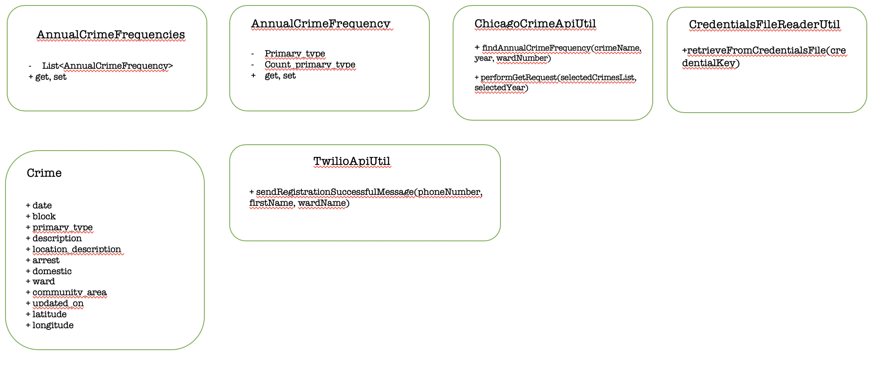
Class Diagram

Slide 6
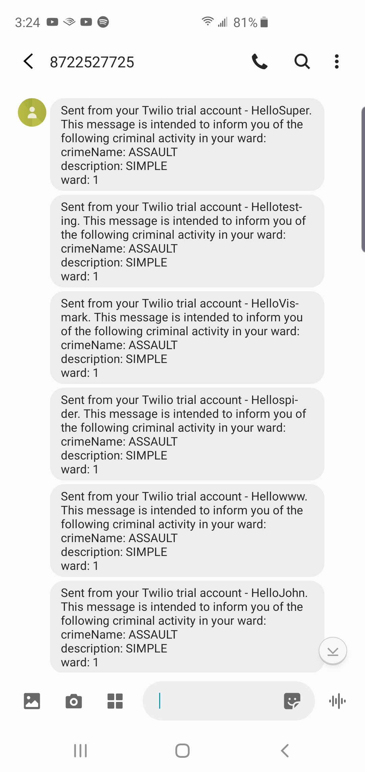
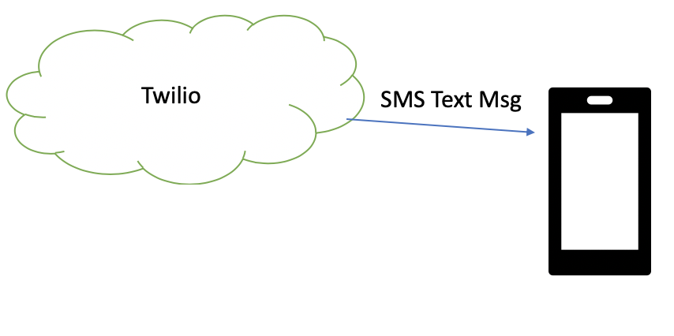
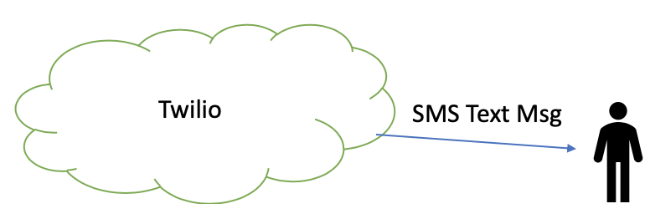
Sequence Diagram

Slide 7
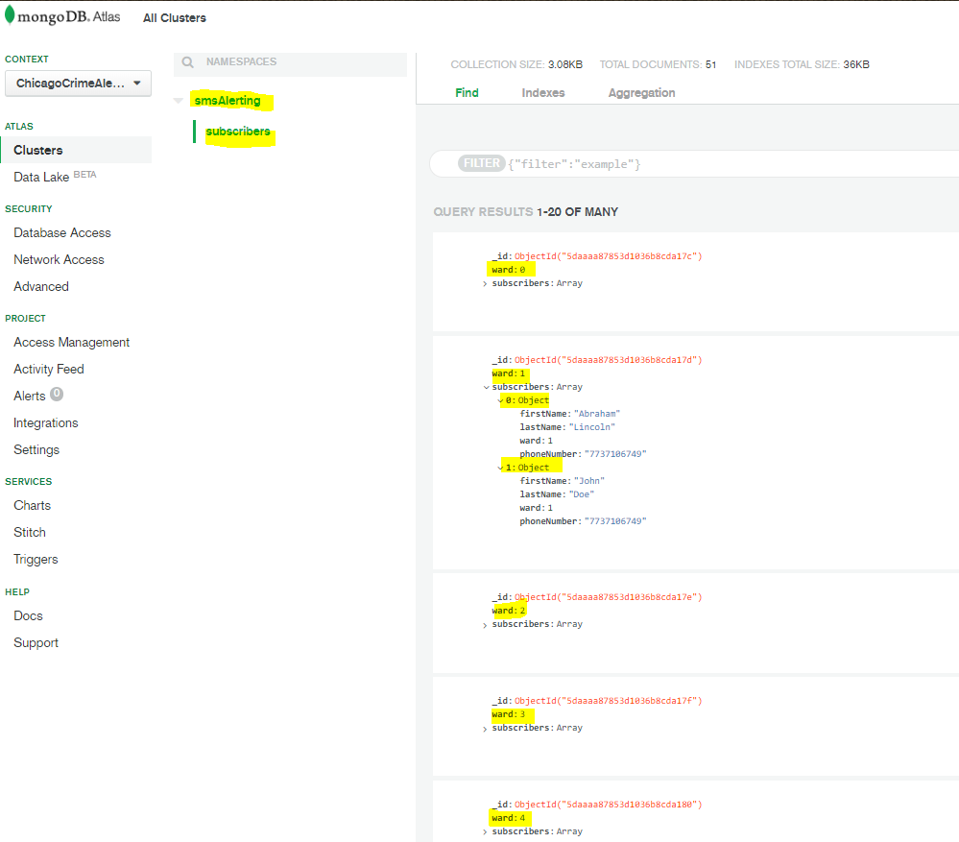
Database (MongoDB Atlas)
Cluster Name: Chicago Crime Alerts Application
Database Name: SmsAlerting
Collections (Equivalent to ‘tables’ in SQL):
Subscribers: Holds one document entry for each of Chicago’s 50 wards.
As users subscribe, they will be added to a list of subscribers for their specific ward

Slide 8
Function Description
Description: The application gives up to date crime statistics, alerts a users mobile phone of important update on either local or relevant crimes, and is used as a browser of curated news articles.
User Interface: User interface is comprised of a WinForms application that handles all user data input, displays graphs, news, etc. It is the main and only user interface at this time, and all features are present in it.
Inputs: Mouse and keyboard, clicking a top menu for navigation through the application. There are also several textboxes used for user data input, as well as selection of data from the crime statistics API.
Processing: Processing includes fetching data from APIs and displaying it in the graph, storing user data in a database, and notifications to a user’s mobile phone through the Twilio API.

